Slide 1

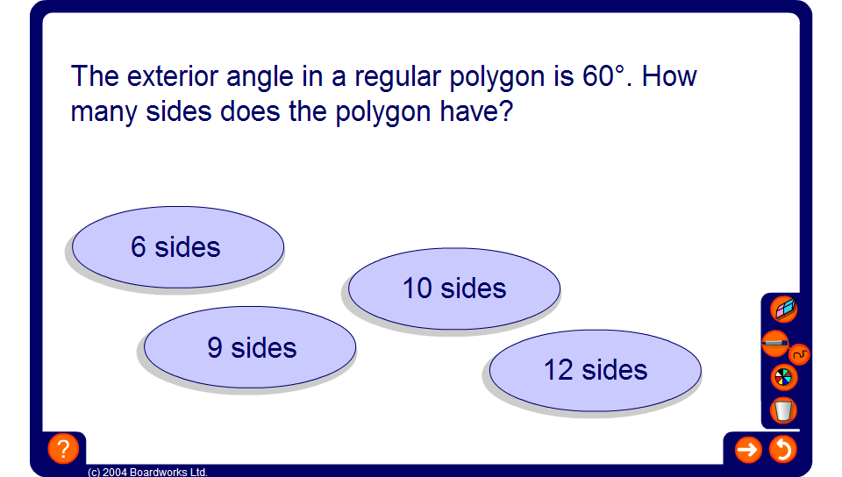


Find the number of sides
Notes:
Challenge pupils to find the number of sides in a regular polygon given the size of one of its interior or exterior angles.
Establish that if we are given the size of the exterior angle we have to divide this number into 360° to find the number of sides. This is because the sum of the exterior angles in a polygon is always 360° and each exterior angle is equal.
Establish that if we are given the size of the interior angle we have to divide 360° by (180° – the size of the interior angle) to find the number of sides. This is because the interior angles in a regular polygon can be found by subtracting 360° divided by the number of sides from 180°.

